Slide 1
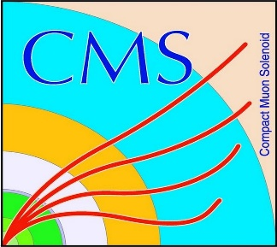

HEP Weekly Report
George Bakas
NTUA

Slide 2
Progress Report
DCS
Redundancy task
Analysis
Theoretical top anti-top pair spin correlation in fully hadronic decay
Produced ntuple that has just 5 variables
Particle Id, Mass, P_{T}, phi, eta
Started plotting histograms with angular distributions for dileptonic, semileptonic final states of the ttbar decay
Δφ distributions in Lab frame for dileptonic
Distribution of cos(theta_{helicity}^{l+} )cos(theta_{helicity}^{l-}) where the helicity angle is the angle between the lepton and the top quark in the W rest frame
Distribution of cos(theta) where theta is the angle of the two leptons in the ttbar Rest frame for the semileptonic decay
Ongoing making a presentation with all the produced histograms for different angular distributions

